Slide 1
Office 365 development

Slide 2
Deep dive into Microsoft Graph for Calendar
</>

Slide 3
Agenda
Overview
Paging support
Batching support
CRUD support
Exchange operations using REST

Slide 4
Developer vision

Slide 5
1
Overview

Slide 6
Microsoft Graph for Calendar, Mail, and Contacts
Microsoft Graph
Mail Message API
Contacts API
Calendar Events API
Microsoft Graph accessible through REST
https://graph.microsoft.com/v1.0/me/messages
https://graph.microsoft.com/v1.0/me/contacts
https://graph.microsoft.com/v1.0/me/events
Exchange Direct Endpoint APIs accessible through OutlookServicesClient
A library which abstracts away sending and receiving REST requests with .NET

Slide 7
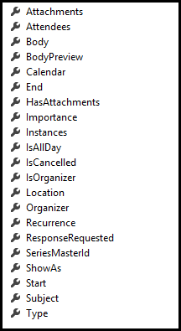
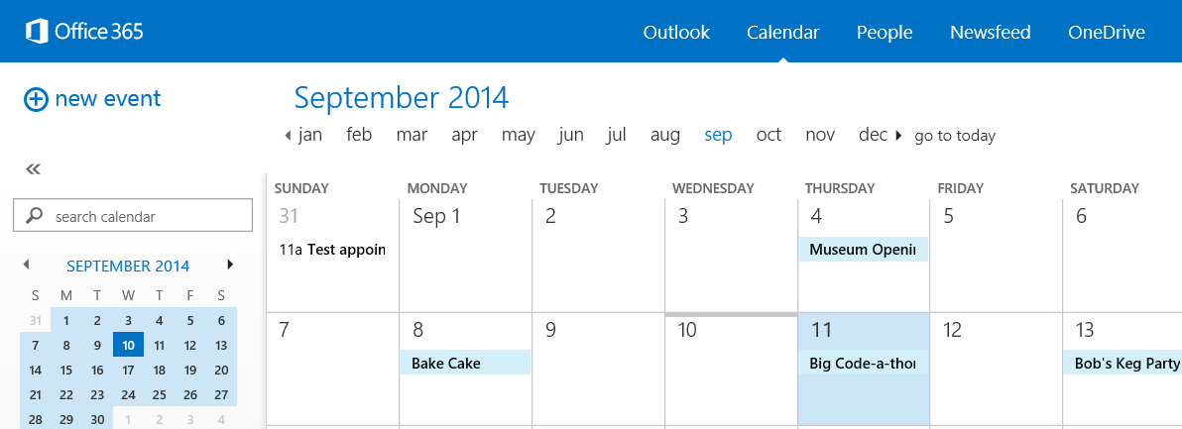
Calendar events
Common API operations
Reading events for specific date range
Creating events
Deleting events
Editing events
EVENT

Slide 8
2
Paging support

Slide 9
Paging with the Microsoft Graph
Paging buttons call GetEvents which skips over the specified number of entities to present the next page
public async Task<List<MyEvent>> GetEvents(int pageIndex, int pageSize)
{
var eventsResults = new List<MyEvent>();
var accessToken = await GetGraphAccessTokenAsync();
var restURL = string.Format("{0}me/events?$top={1}&$skip={2}", SettingsHelper.GraphResourceUrl, pageSize, pageIndex * pageSize);
using (HttpClient client = new HttpClient())
{
var accept = "application/json";
client.DefaultRequestHeaders.Add("Accept", accept);
client.DefaultRequestHeaders.Authorization = new AuthenticationHeaderValue("Bearer", accessToken);
using (var response = await client.GetAsync(restURL))
{
if (response.IsSuccessStatusCode)
{
var jsonresult = JObject.Parse(await response.Content.ReadAsStringAsync());
foreach (var item in jsonresult["value"])
{
eventsResults.Add(new MyEvent
{
Start = !string.IsNullOrEmpty(item["start"]["dateTime"].ToString()) ? DateTime.Parse(item["start"]["dateTime"].ToString()) : new DateTime(),
End = !string.IsNullOrEmpty(item["end"]["dateTime"].ToString()) ? DateTime.Parse(item["end"]["dateTime"].ToString()) : new DateTime(),
});
}
}
}
}
MorePagesAvailable = eventsResults.Count < pageSize ? false : true;
return eventsResults.OrderBy(e => e.Start).ToList();
}

Slide 10
Examining paging support with Microsoft Graph
demo

Slide 11
3
Batching with REST

Slide 12
Each action is sent as a separate request
CSOM allows for multiple requests to be sent as one
Requests are expensive and slow your app
REST is more chatty than CSOM

Slide 13
Microsoft Graph shipped with support for with REST APIs
Batching requests with REST support added to SharePoint Online late 2014
Send multiple write and read operations in one HTTP request
Batching support added to Office 365
SharePoint 2013 on-premises—not supported

Slide 14
Exploring the impact

Slide 15
Batch request
ChangeSet—HTTP POST
Overview: batch request
ChangeSet—HTTP PATCH
ChangeSet—HTTP DELETE
HTTP GET

Slide 16
Batch response
ChangeSet Response
Overview: batch response
ChangeSet Response
ChangeSet Response
HTTP GET Response

Slide 17
4
CRUD support

Slide 18
Getting a specific entity
Event retrieved by calling GetById(id)
public async Task<MyEvent> GetEvent(string id)
{
var accessToken = await GetGraphAccessTokenAsync();
var restURL = string.Format("{0}me/events/{1}", SettingsHelper.GraphResourceUrl, id);
var ev = new MyEvent();
try
{
using (HttpClient client = new HttpClient())
{
var accept = "application/json";
client.DefaultRequestHeaders.Add("Accept", accept);
client.DefaultRequestHeaders.Authorization = new AuthenticationHeaderValue("Bearer", accessToken);
using (var response = await client.GetAsync(restURL))
{
if (response.IsSuccessStatusCode)
{
var item = JObject.Parse(await response.Content.ReadAsStringAsync());
if (item != null)
{
ev.Start = !string.IsNullOrEmpty(item["start"]["dateTime"].ToString()) ? DateTime.Parse(item["start"]["dateTime"].ToString()) : new DateTime();
ev.End = !string.IsNullOrEmpty(item["end"]["dateTime"].ToString()) ? DateTime.Parse(item["end"]["dateTime"].ToString()) : new DateTime();
ev.Id = !string.IsNullOrEmpty(item["id"].ToString()) ? item["id"].ToString() : string.Empty;
ev.Subject = !string.IsNullOrEmpty(item["subject"].ToString()) ? item["subject"].ToString() : string.Empty;
ev.Body = !string.IsNullOrEmpty(item["body"].ToString()) ? item["body"]["content"].ToString() : string.Empty;
ev.Location = !string.IsNullOrEmpty(item["location"].ToString()) ? item["location"]["displayName"].ToString() : string.Empty;
}
}
}
}
}
catch (Exception el)
{
el.ToString();
}
return ev;
}

Slide 19
Deleting a specific entity
Event deleted by calling DeleteAsync() on Contact object
public async Task DeleteEvent(string id)
{
var accessToken = await GetGraphAccessTokenAsync();
var restURL = string.Format("{0}me/events('{1}')", SettingsHelper.GraphResourceUrl, id);
try
{
using (HttpClient client = new HttpClient())
{
var accept = "application/json";
client.DefaultRequestHeaders.Add("Accept", accept);
client.DefaultRequestHeaders.Authorization = new AuthenticationHeaderValue("Bearer", accessToken);
using (var response = await client.DeleteAsync(restURL))
{
if (response.IsSuccessStatusCode)
return;
else
throw new Exception("delete event error: " + response.StatusCode);
}
}
}
catch (Exception el)
{
el.ToString();
}
}

Slide 20
Adding an entity
Event added by calling AddEvent()
public async Task AddEvent(MyEvent myEvent)
{
var accessToken = await GetGraphAccessTokenAsync();
var restURL = string.Format("{0}me/events", SettingsHelper.GraphResourceUrl);
try
{
using (HttpClient client = new HttpClient())
{
var accept = "application/json";
client.DefaultRequestHeaders.Add("Accept", accept);
client.DefaultRequestHeaders.Authorization = new AuthenticationHeaderValue("Bearer", accessToken);
var ev = new Event
{
Subject = myEvent.Subject,
Start = new Start { dateTime = myEvent.Start.ToString() },
End = new End { dateTime = myEvent.End.ToString() },
Location = new Location { displayName = myEvent.Location },
Body = new Body { content = myEvent.Body }
};
string postBody = JsonConvert.SerializeObject(ev);
using (var response = await client.PostAsync(restURL, new StringContent(postBody, Encoding.UTF8, "application/json")))
{
if (response.IsSuccessStatusCode)
return;
else
throw new Exception("add event error: " + response.StatusCode);
}
}
}
catch (Exception el)
{
el.ToString();
}
}

Slide 21
Update operations with the Microsoft Graph
demo

Slide 22
5
Exchange operations with REST

Slide 23
Microsoft Graph
https://graph.microsoft.com/v1.0/me/drive/root/children
https://graph.microsoft.com/v1.0/me/messages
https://graph.microsoft.com/v1.0/me/events
https://graph.microsoft.com/v1.0/me/events(<event_id>)
https://graph.microsoft.com/v1.0/me/calendar
https://graph.microsoft.com/v1.0/me/calendar/events
https://graph.microsoft.com/v1.0/me/calendars(<calendar_id>)/events
https://graph.microsoft.com/v1.0/me/contacts
https://graph.microsoft.com/v1.0/me/contacts(<contact_id>)

Slide 24
Reading entities using REST
HTTP GET request to collection or entity endpoint Microsoft Graph only returns JSON responses Paging is accomplished using $skip and $top
public async Task<List<MyContact>> GetContacts(int pageIndex, int pageSize)
{
var contactsResults = new List<MyContact>();
var accessToken = await GetGraphAccessTokenAsync();
var restURL = string.Format("{0}me/contacts?$top={1}&$skip={2}", SettingsHelper.GraphResourceUrl, pageSize, pageIndex * pageSize);
using (HttpClient client = new HttpClient())
{
var accept = "application/json";
client.DefaultRequestHeaders.Add("Accept", accept);
client.DefaultRequestHeaders.Authorization = new AuthenticationHeaderValue("Bearer", accessToken);
using (var response = await client.GetAsync(restURL))
{
if (response.IsSuccessStatusCode)
{
var jsonresult = JObject.Parse(await response.Content.ReadAsStringAsync());
foreach (var item in jsonresult["value"])
{
contactsResults.Add(new MyContact
{
Id = !string.IsNullOrEmpty(item["id"].ToString()) ? item["id"].ToString() : string.Empty,
GivenName = !string.IsNullOrEmpty(item["givenName"].ToString()) ? item["givenName"].ToString() : string.Empty,
});
}
}
}
}
MorePagesAvailable = contactsResults.Count < pageSize ? false : true;
return contactsResults;
}

Slide 25
Adding a new entity
HTTP POST to collection endpoint to add an entity
Provide minimum of @data.type property
public async Task AddContact(MyContact myContact)
{
var accessToken = await GetGraphAccessTokenAsync();
var restURL = string.Format("{0}me/contacts", SettingsHelper.GraphResourceUrl);
try
{
using (HttpClient client = new HttpClient())
{
var accept = "application/json";
client.DefaultRequestHeaders.Add("Accept", accept);
client.DefaultRequestHeaders.Authorization = new AuthenticationHeaderValue("Bearer", accessToken);
string postBody = JsonConvert.SerializeObject(myContact);
using (var response = await client.PostAsync(restURL, new StringContent(postBody, Encoding.UTF8, "application/json")))
{
if (response.IsSuccessStatusCode)
return;
else
throw new Exception("add contact error: " + response.StatusCode);
}
}
}
catch (Exception el)
{
el.ToString();
}
}

Slide 26
Deleting an entity
HTTP DELETE to specific entity endpoint
public async Task DeleteContact(string id)
{
var accessToken = await GetGraphAccessTokenAsync();
var restURL = string.Format("{0}me/contacts('{1}')", SettingsHelper.GraphResourceUrl, id);
try
{
using (HttpClient client = new HttpClient())
{
var accept = "application/json";
client.DefaultRequestHeaders.Add("Accept", accept);
client.DefaultRequestHeaders.Authorization = new AuthenticationHeaderValue("Bearer", accessToken);
using (var response = await client.DeleteAsync(restURL))
{
if (response.IsSuccessStatusCode)
return;
else
throw new Exception("delete contact error: " + response.StatusCode);
}
}
}
catch (Exception el)
{
el.ToString();
}
}

Slide 27
Exchange operations using the Microsoft Graph
demo

Slide 28
Summary
Overview
Paging support
Batching support
CRUD support
Exchange operations using REST

Slide 29
Developer Program launch
1 YEAR FREE
Email Newsletters
Free Developer Subscription
Free Training
Free Tools
Webinars
http://dev.office.com/devprogram

Slide 30
Engage

